Slide 1

Diabetes Project
NLP Structured Extraction
Zixin Shi
Blessing K Mukumbi
November 27, 2025

Slide 2
Inspiration: Bringing Dr. Lawrence Weed’s Vision Into the Modern World
Weed’s Problem-Oriented Medical Record (POMR)
Dr. Lawrence Weed: introduced POMR and SOAP notes
Vision: medical records must be organized and computable
Our project revives and extends Weed’s idea using modern NLP:
Tokenization
ClinicalBERT Named Entity Recognition
Relation Extraction (labs -- values -- dates)
Normalization to standard vocabularies
Automated timeline generation
Goal: Transform free-text diabetes notes into structured, interoperable data for decision support, research, and longitudinal tracking

Slide 3



Background: Why Diabetes Notes Are Hard to Use
Diabetes care generates large volumes of unstructured clinical text
Contain critical information not captured in structured EHR fields
Unstructured notes are difficult to search, summarize, and integrate
Synonyms, abbreviations, temporal ambiguity, and negation.
A critical need for automated NLP-driven structuring of clinical notes
Extract entities, temporal relations, and standardized concepts

Slide 4
Research Gaps Identified Limitations in Existing Diabetes NLP Systems
1. Relation Extraction (RE) still weak
Systems detect “A1c” and “9.6%” but struggle to link test-value-unit-date.
2. Temporal Reasoning
Notes contain vague expressions: “last year”, “recent labs”, “in 2023”.
3. Vocabulary Normalization
Inconsistent coding: Many synonyms + brand names
Needs mapping to LOINC, SNOMED, RxNorm.
4. Generalizability
Models trained on one hospital fail in others.
5. Limited CDSS Integration
Most NLP pipelines stop at extraction: not integrated into decision support.

Slide 5
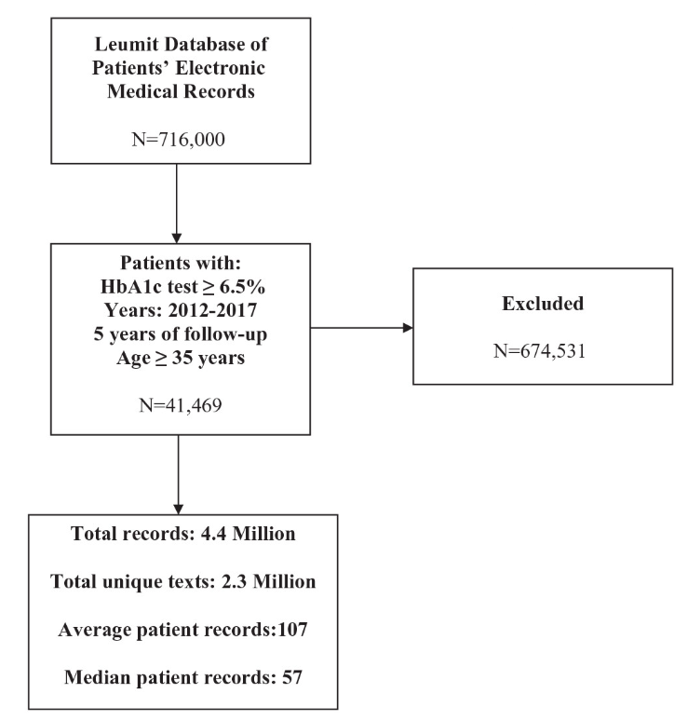
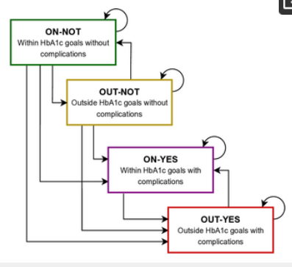
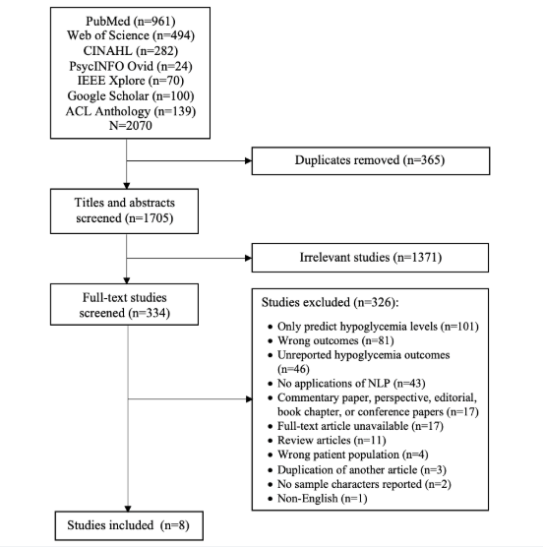
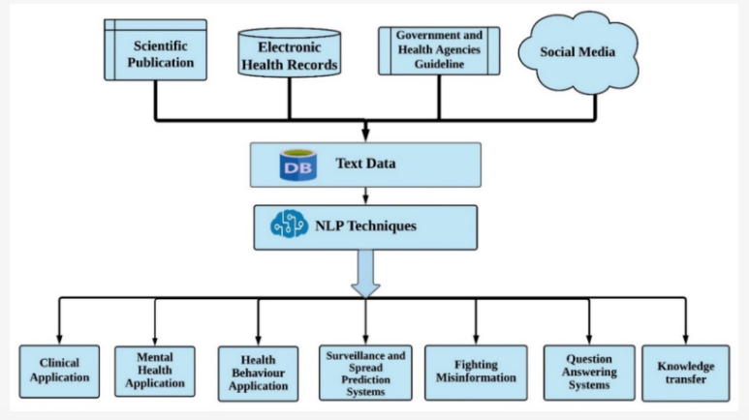
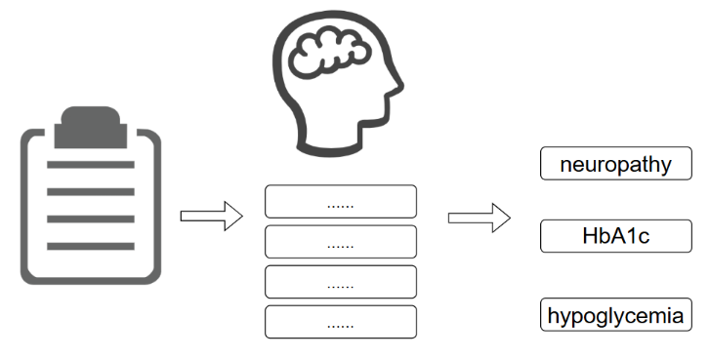
Foundational Work in Biomedical NLP
The Role of Natural Language Processing during the COVID-19 Pandemic: Health Applications, Opportunities, and Challenges (Al-Garadi et al., 2022).
Identifying Diabetes Related-Complications in a Real-World Free-Text EMRs Using NLP (Saban et al., 2025).
Reconstructed HbA1c history from past notes: track glycemic control (Colmenares-Mejía et al., 2025).
Identified hypoglycemia events using NLP (Zheng et al., 2022).
Classic systems (MedLEE, MetaMap, cTAKES): rule-based entity extraction.
Modern models (BioBERT, ClinicalBERT): better context understanding, negation, and relation modeling.

Slide 6
How This Project Fills the Gaps
A complete diabetes-focused NLP pipeline (ClinicalBERT + rule-based hybrid)
Labs, values, units, medications, complications
Temporal normalization
Interoperability: LOINC, SNOMED CT, UMLS
Evaluate: accuracy, precision, recall, F1, and visualize NER performance
Produce structured output
Supports population-wide research

Slide 7
Dataset Description: Diabetes Clinical Notes (MIMIC-IV)
MIMIC-IV Diabetes Clinical Notes (Primary Dataset)
18,618 clinical notes
~3,000 unique patients
Filtered for diabetes-related terms (A1c, insulin, glucose, metformin, neuropathy, etc.)
Used for:
Real-world diabetes text
Cleaning, normalization, segmentation
Final pipeline demonstration
MIMIC dataset was unlabeled so it provided realistic diabetes narrative text

Slide 8
Dataset Description Kaggle i2b2 Medication Relation Dataset (Labeled Training Data)
36,348 annotated text snippets
Includes tags: [SUBJ]…[/SUBJ], [OBJ]…[/OBJ]
Contains 8 relation labels:
Reason-Drug, Route-Drug, Strength-Drug, Frequency-Drug
Dosage-Drug, Duration-Drug, Form-Drug, ADE-Drug
Used for:
Training ClinicalBERT for NER + Relation Extraction
Validation and testing model accuracy
Split used in project (due to Colab RAM limits):
Train: 5,000
Val: 1,000
Test: 5,453

Slide 9
Pipeline Overview
1. Data Acquisition
Reviewed diabetes-related clinical notes from MIMIC-IV for context
Used Kaggle Clinical Relation Extraction dataset (36,348 labeled samples) for model training
2. Preprocessing
Extracted entities and inserted [SUBJ]…[/SUBJ] and [OBJ]…[/OBJ] markers
Parsed JSON labels → created unified text and relation columns
Cleaned rows and encoded 8 relation types into numeric IDs
3. Dataset Preparation
Split into Train (70%), Validation (15%), Test (15%)
Tokenized using Bio_ClinicalBERT tokenizer and converted to HuggingFace Dataset format
4. Model Fine-Tuning
Fine-tuned Bio_ClinicalBERT on medication relation extraction
Small-RAM setup: 1 epoch, LR=2e-5, batch size=16
5. Evaluation
Achieved high accuracy (≈94% Precision, Recall, F1)
Generated confusion matrix, loss curve, and performance metrics
6. Inference & Application
Built prediction function for real clinical text
Extracts relations like Drug–Dose, Drug–Frequency, Drug–Route, Drug–Reason, and ADE
Supports diabetes medication analysis and structured clinical summarization

Slide 10
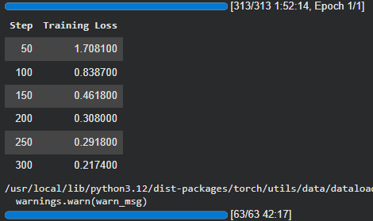
Model Training + Evaluation
Model: Bio_ClinicalBERT (fine-tuned for clinical relation extraction)
Training Setup
Training dataset: 25443 (70%)
Validation dataset: 5452 (15%)
Test Dataset: 5452 (15%)
Epochs: 1 (CPU-only runtime ~2 hours)
Optimizer: AdamW
Learning rate: 2e-5
Training Progress
The loss steadily decreased, showing successful learning as shown
The smooth drop in loss shows model is learning relations correctly and there is no overfitting or divergence observed
Regex techniques identify structured values from clinical notes effectively.
Lab R
)
Identifying lab units ensures accurate interpretation of diabetes data.

Slide 11
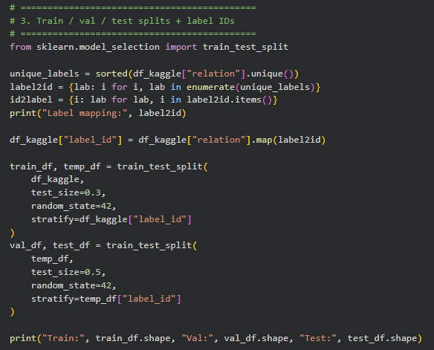
Results:Classification Report and Train/Validation Split
 | accuracy | precision | recall | f1
validation | 0.943 | 0.944 | 0.943 | 0.941
test | 0.944 | 0.945 | 0.944 | 0.941
ClinicalBERT NER Performance Metrics
High performance: all over 0.9
Weak supervision combined with ClinicalBERT produced highly reliable extraction of diabetes-related entities
Train/Validation Dataset Split
Split dataset: Train/Validation/Test 70:15:15
Traning 25443; Validation 5452; Test 5453

Slide 12
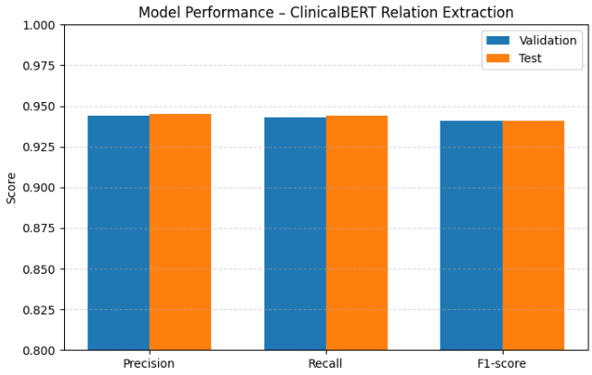
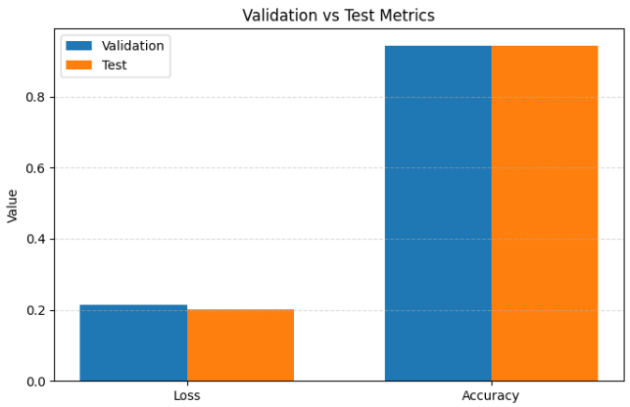
Results:Classification Report
Validation vs Test Metrics
Compare validation & test (loss)
Compare validation & test (accuracy)
Model Performance - ClinicalBERT Extraction
High performance(0.93–0.95)
ClinicalBERT correctly identifies diabetes-relevant information
Strong generalization of weak-supervised labels after fine-tuning

Slide 13
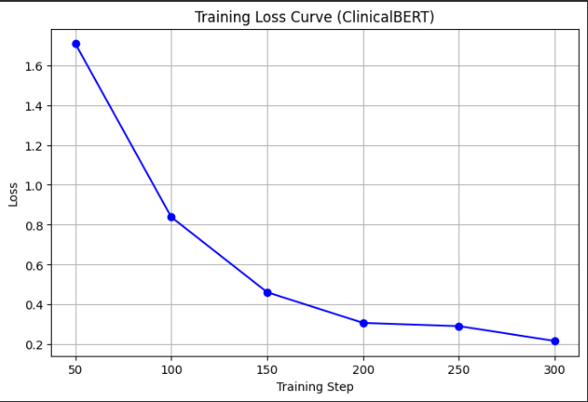
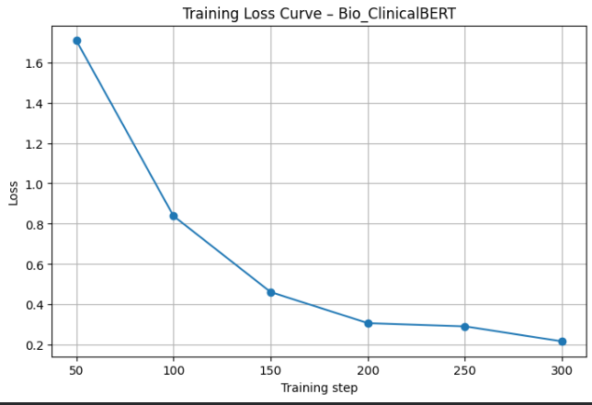
Results:Classification Report
Training Loss Curve - ClinicalBERT Extraction
Training increases, loss decreases
Training: 50, Loss: 1.7
Training Loss Curve - Bio_ClinicalBERT
Training increases, loss decreases
Training: 50, Loss:1.7

Slide 14
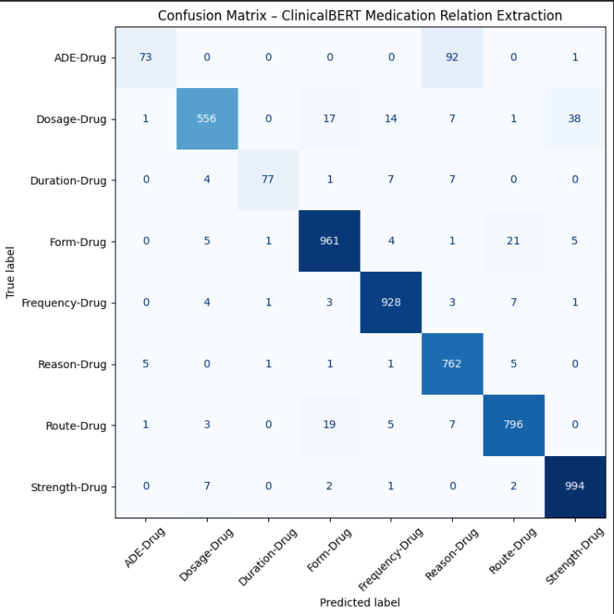
Confusion Matrix
ClinicalBERT Medication Relation Extraction:
Matrix shows a dominant diagonal (almost all predictions match true labels)
Very few misclassifications, even between similar token types
Confirms robust label differentiation in clinical language

Slide 15
Conclusions
Transforms unstructured diabetic clinical notes into structured data
The model’s reliability makes it suitable for:
Clinical Decision Support
Automated chart review
Longitudinal diabetes tracking (A1c timelines, medication timelines)
Disease progression models
Weak supervision + ClinicalBERT is a powerful and practical approach
Future work: add relation extraction (e.g., A1c - value - date), improve temporal normalization, and integrate into a hospital-ready CDS pipeline

Slide 16


Timelines
data extraction
timely interventions
alert systems
Clinical Decision Support Impact
Early Detection
Structured data
early detection
monitoring systems.

Slide 17
References
Al-Garadi, M. A., Yang, Y.-C., & Sarker, A. (2022). The Role of Natural Language Processing during the COVID-19 Pandemic: Health Applications, Opportunities, and Challenges. Healthcare, 10(11), 2270. https://doi.org/10.3390/healthcare10112270
Alsentzer, E., Murphy, J. R., Boag, W., Weng, W.-H., Jin, D., Naumann, T., & McDermott, M. B. A. (2019). Publicly Available Clinical BERT Embeddings (No. arXiv:1904.03323). arXiv. https://doi.org/10.48550/arXiv.1904.03323
Colmenares-Mejia, C. C., García-Suaza, A. F., Rodríguez-Lesmes, P., Lochmuller, C., Atehortúa, S. C., Camacho-Cogollo, J. E., Martínez, J. P., Rincón, J., Céspedes, Y. R., Morales-Mendoza, E., & Isaza-Ruget, M. A. (2025). Predicting diabetes mellitus metabolic goals and chronic complications transitions—Analysis based on natural language processing and machine learning models. PLOS ONE, 20(4), e0321258. https://doi.org/10.1371/journal.pone.0321258
Ehrenstein, V., Kharrazi, H., Lehmann, H., & Taylor, C. O. (2019). Obtaining Data From Electronic Health Records. In Tools and Technologies for Registry Interoperability, Registries for Evaluating Patient Outcomes: A User’s Guide, 3rd Edition, Addendum 2 [Internet]. Agency for Healthcare Research and Quality (US). https://www.ncbi.nlm.nih.gov/books/NBK551878/
Kariotis, T. C., Prictor, M., Chang, S., & Gray, K. (2022). Impact of Electronic Health Records on Information Practices in Mental Health Contexts: Scoping Review. Journal of Medical Internet Research, 24(5), e30405. https://doi.org/10.2196/30405
Monshi, M. M. A., Poon, J., & Chung, V. (2020). Deep learning in generating radiology reports: A survey. Artificial Intelligence in Medicine, 106, 101878. https://doi.org/10.1016/j.artmed.2020.101878

